Slide 1

Muniappan.M - DA & DS
Housing
01

Slide 2
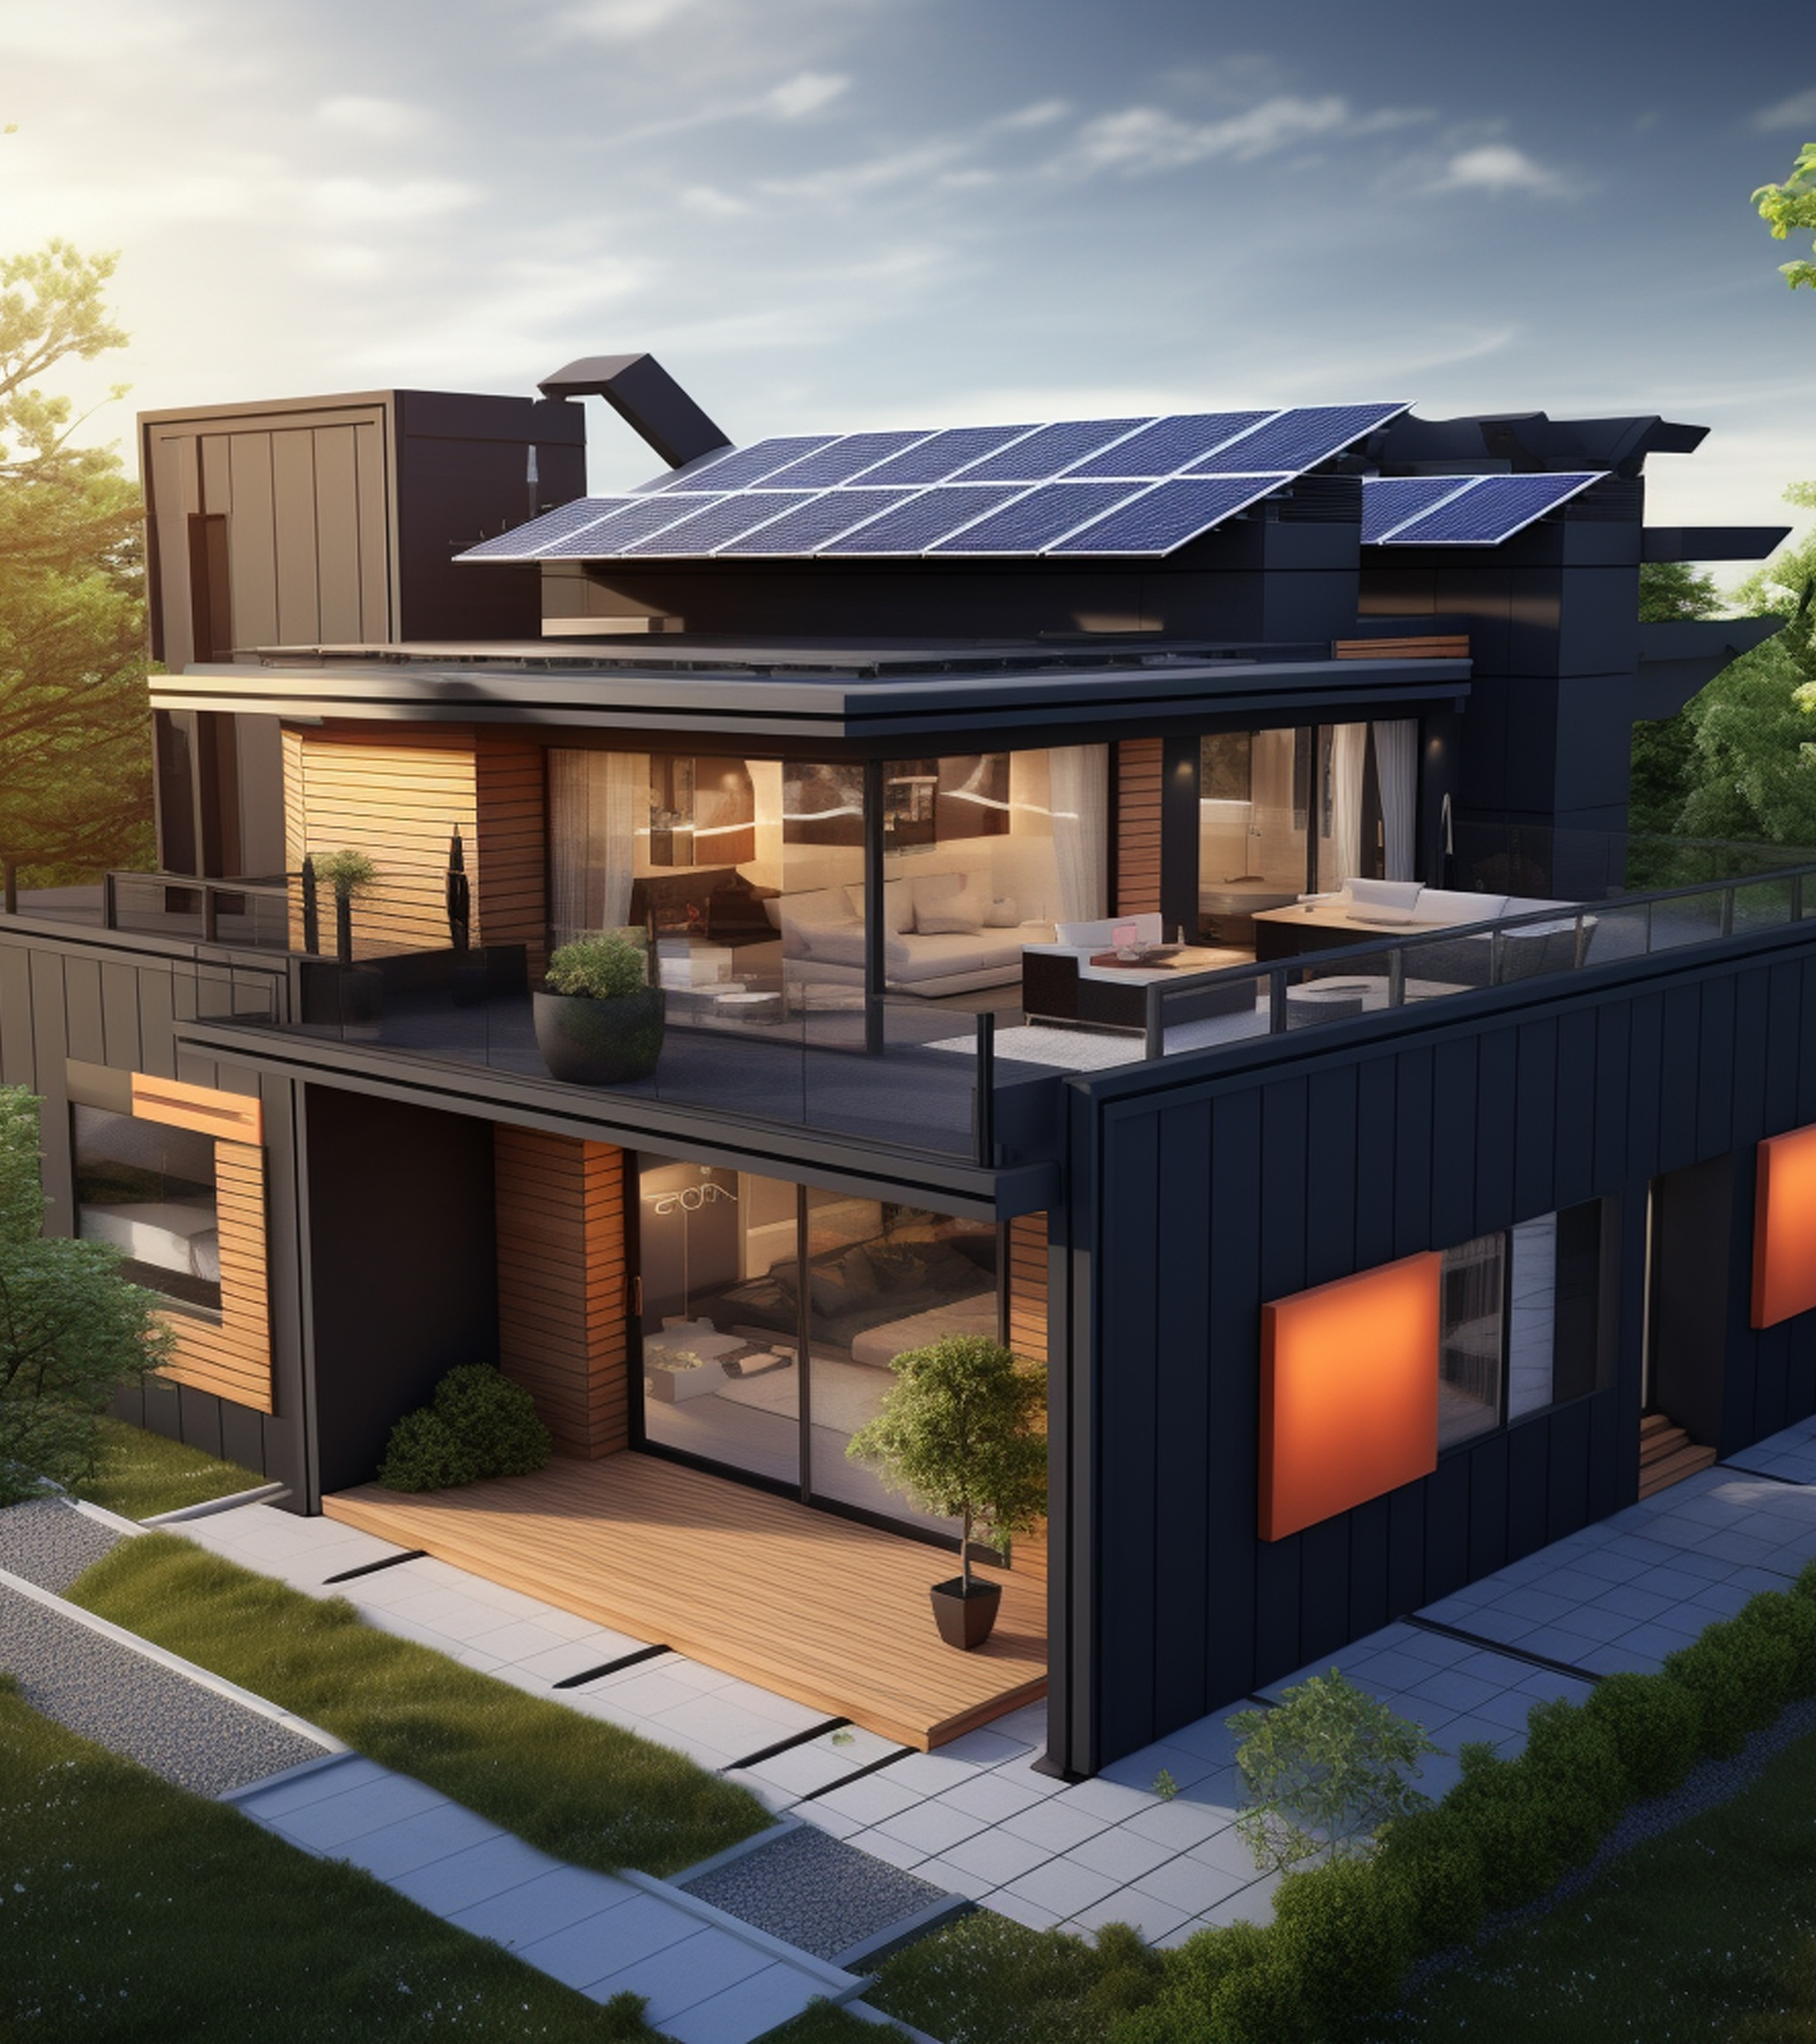
AGENDA
DATA UNDERSTANDING
DATA CLEANING
EDA (Exploratory Data Analysis)
UNIVARIATE ANALYSIS
BIVARIATE ANALYSIS
MULTIVARAIATE ANALYSIS
INSIGHTS
02

Slide 3

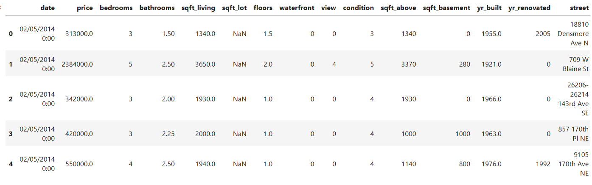
DATA UNDERSTANDING
Provide a detailed description of the dataset, including its structure, dimensions (rows and columns), and data types.
Include a summary of the initial exploratory analysis, such as basic statistics and early insights gained
03

Slide 4
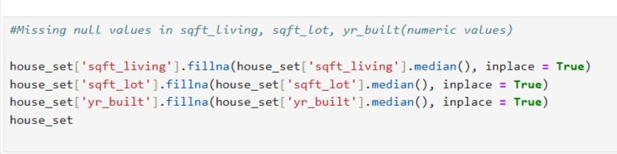
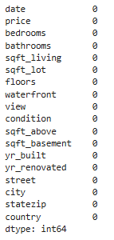
Timmerman Industries
DATA CLEANING
DATA CLEANING
Explain the methods used to clean the data, including how missing values were imputed.
Describe how outliers were identified and handled, and how any inconsistent data points were corrected or removed.
04

Slide 5

Timmerman Industries
EDA (Exploratory Data Analysis)
01
UNIVARIATE ANALYSIS
Discuss the results of univariate analysis, including insights gained from individual variables.
Highlight key statistics and visualizations (e.g., histograms, box plots) for each variable.
02
BIVARIATE ANALYSIS
03
MULTIVARIATE ANALYSIS
Examine the relationships between pairs of variables.
Discuss how these variables correlate or interact with each other, including visualizations (e.g., scatter plots, correlation matrices) and any statistical tests performed.
Explore the relationships among three or more variables simultaneously.
Use techniques such as multiple regression, PCA, or advanced visualization methods to understand complex interactions in the data.
05

Slide 6

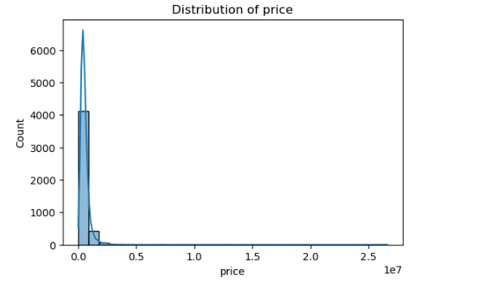
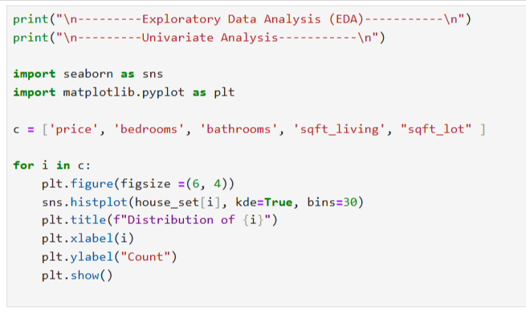
UNIVARIATE ANALYSIS
.
Discuss the results of univariate analysis, including insights gained from individual variables.
Highlight key statistics and visualizations (e.g., histograms, box plots) for each variable.
02
06

Slide 7
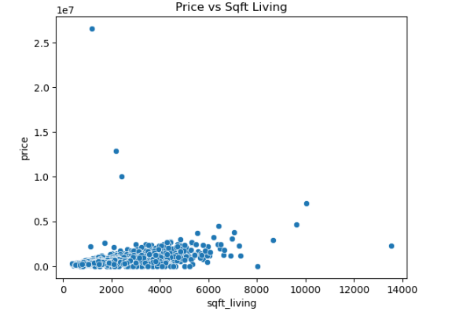
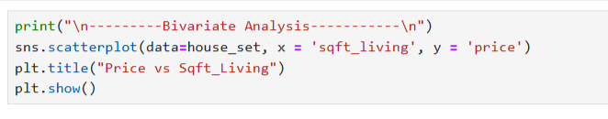
BIVARIATE ANALYSIS
Examine the relationships between pairs of variables.
Discuss how these variables correlate or interact with each other, including visualizations (e.g., scatter plots, correlation matrices) and any statistical tests performed.
07

Slide 8
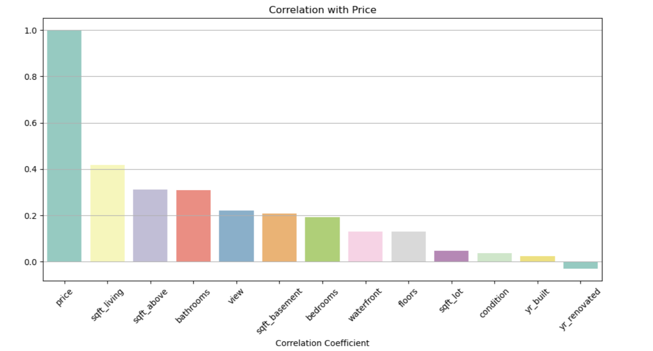
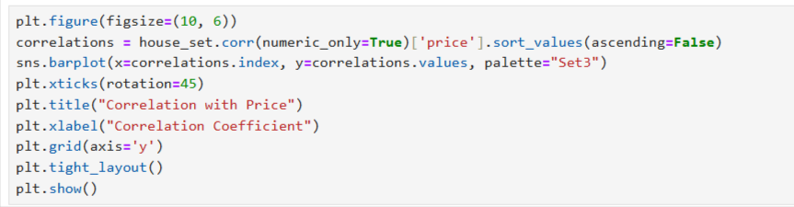
Timmerman Industries
MULTIVARIATE ANALYSIS
Explore the relationships among three or more variables simultaneously.
Use techniques such as multiple regression, PCA, or advanced visualization methods to understand complex interactions in the data.
08

Slide 9

Timmerman Industries
INSIGHTS
1. Average House Price
→ You are calculating the average price across all cities, likely to identify the market trend.
2. Most Expensive City (by Average Price)
→ Using groupby('city')['price'].mean() to find which city has the highest average housing cost.
3. Missing Value Handling
→ sqft_living, sqft_lot, and yr_built are filled with their median values.
→ city is filled with the mode (most frequent city).
4. Top Correlated Feature with Price
→ You planned a correlation heatmap to understand which variable (e.g., sqft_living) influences price the most.
5. Data Cleaning Steps
→ Duplicates were dropped and types were converted (price, floors, bathrooms to integers).
→ Date was parsed and forward-filled.
09

Slide 10

Thank You
10

